Slide 1


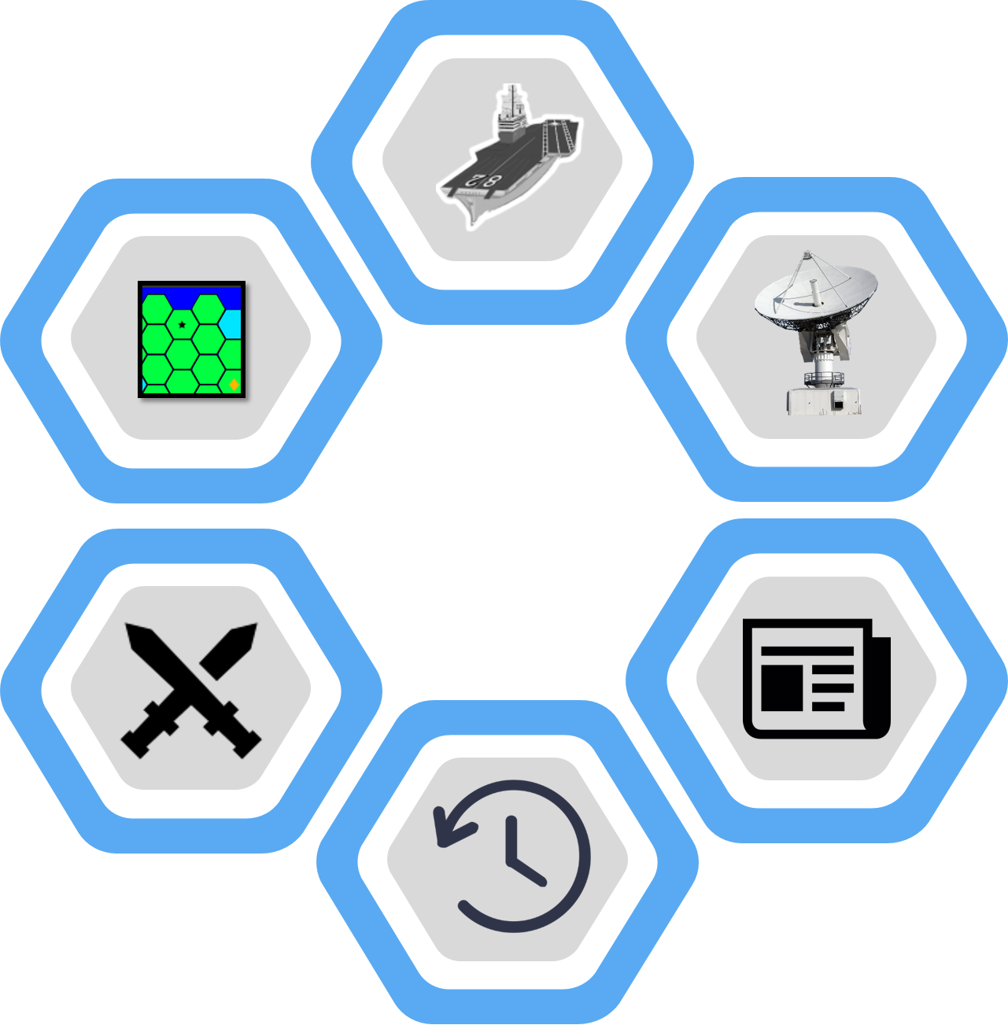
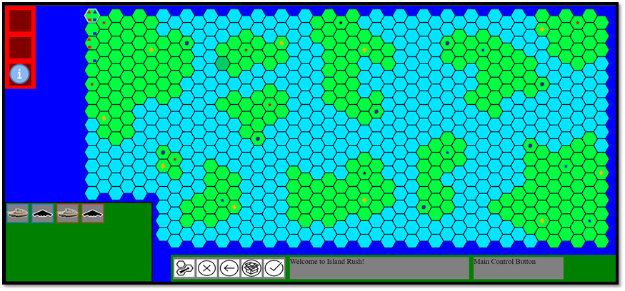
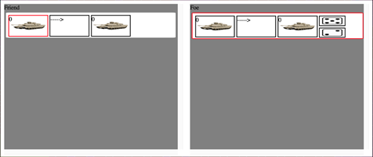

Island Rush: K3
A Military Strategy Teaching Game
Group Members: David Huarng, Jonathan Weishuhn, Minhawn Oh, Spencer Adolph, Shipeng Yang, Bozhao Zhang, Barret Pickett
CSCE 606 Project Poster
Introduction
Design
Lessons Learned
Military Strategy Teaching Board Game for USAFA.
Game is played through a web-app
Consists of two teams of 4-5 students
Objective: Teams make real-time actions to place and move units, battle the enemy, conquer island territories, and ultimately capture the opposing team’s home island
Combat Arena
Units
Better documentation in code for other developers to understand and take over
Better file classification for other developers to navigate code
Better documentation on the project itself for other non-coding people to understand the project
Hex grid layout
Land and water tiles
Island terrain
Different types of Units: Air, Land, SOF, Maritime
Different costs and abilities
Battles
Capabilities
Round-based RNG battles
Units have strengths and weaknesses
Special abilities commanders can purchase and use
Different types: Cyber, Space, Nuclear, Unconventional
Real-time Actions
News Alert
Async design allows for real-time actions
Distinct phases: News Alert, Purchasing, Planning, Execution
Provide info for in-game events
Various levels of impact on in-game activities
Technologies Used
Challenges
Solutions
Results & Conclusions
Node.js
Frontend
Backend
Redux
React
MySQL
Azure
Production
Legacy code hard to understand. (Little Documentation and large code base)
Not everyone is familiar with Javascript(Node, React, Redux) or SQL
Watch Youtube tutorial videos on the things we are working on
Project owner walks through the code and explain it very detailed to all of the developers
We made the game work and met requirements of our customers, although there are still more features that need to be done. We did a lot of work on documenting the whole project(including non-coding part) so that the contractors that our customers hire would have a better understanding of the whole game and the code base.

